Slide 1


Patients condition Classification using drugs reviews (NLP Project)

Slide 2
Groups Members and Mentors Name
Groups Members Names
Mentors Name
Mentor –
Co Mentor -

Slide 3
Problem Statememt
Large volumes of patient drug reviews are available in textual format.
Manual analysis of these reviews to identify patient conditions is difficult and time-consuming.
There is a need for an automated system to analyze patient reviews efficiently.
Use Natural Language Processing (NLP) techniques to process review text.
Develop a machine learning model to classify patient conditions based on reviews.
Focus on classification of Depression, High Blood Pressure, and Type-2 Diabetes.
Deploy the trained model as a web application for practical usage

Slide 4
Project Objectives
Primary Objective
To develop an NLP-based machine learning model that analyzes patient drug reviews and accurately classifies the patient’s condition (Depression, High Blood Pressure, Type-2 Diabetes).
Secondary Objectives
To preprocess and clean textual review data for analysis.
To perform Exploratory Data Analysis (EDA) to understand data patterns.
To apply feature extraction techniques such as TF-IDF.
To train and evaluate different classification algorithms.
To deploy the final model using Flask/Streamlit for real-time prediction.

Slide 5
Dataset Overview
Dataset Descriptions
The dataset used in this project consists of patient drug reviews collected from an online drug review platform.
It contains both structured and unstructured data, making it suitable for Natural Language Processing tasks.
Dataset Details
Total Records: 161,297
Data Type: Text + Numerical
Domain: Healthcare / Medical Reviews
Columns Names | Description
drugName | Name of the prescribed drug
condition | Medical condition of the patient (Target Variable)
review | Patient’s textual drug review
rating | Rating given by the patient (1–10)
date | Date when the review was posted

Slide 6
Data Preprocessing
Preprocessing Step Performed
Removed missing and duplicate records.
Selected required conditions (Depression, High Blood Pressure, Type-2 Diabetes).
Converted text data into lowercase format.
Removed punctuation, numbers, and special characters.
Removed stopwords (common words like is, the, and).
Applied tokenization to split text into words.
Performed stemming/lemmatization to reduce words to root form.
Converted cleaned text into numerical features using TF-IDF/Count Vectorizer for model training

Slide 7
Exploratory Data Analysis (EDA)
EDA steps:
Checked dataset size, structure, and data types.
Identified and handled missing values.
Analyzed the distribution of different conditions in the dataset.
Examined the distribution of ratings given by patients.
Identified the most frequently used drugs for each condition.
Analyzed the length of reviews and review frequency.
Visualized relationships between ratings and conditions using charts.
Generated word frequency / word cloud to identify commonly used words in reviews.
Checked class imbalance among selected conditions.

Slide 8
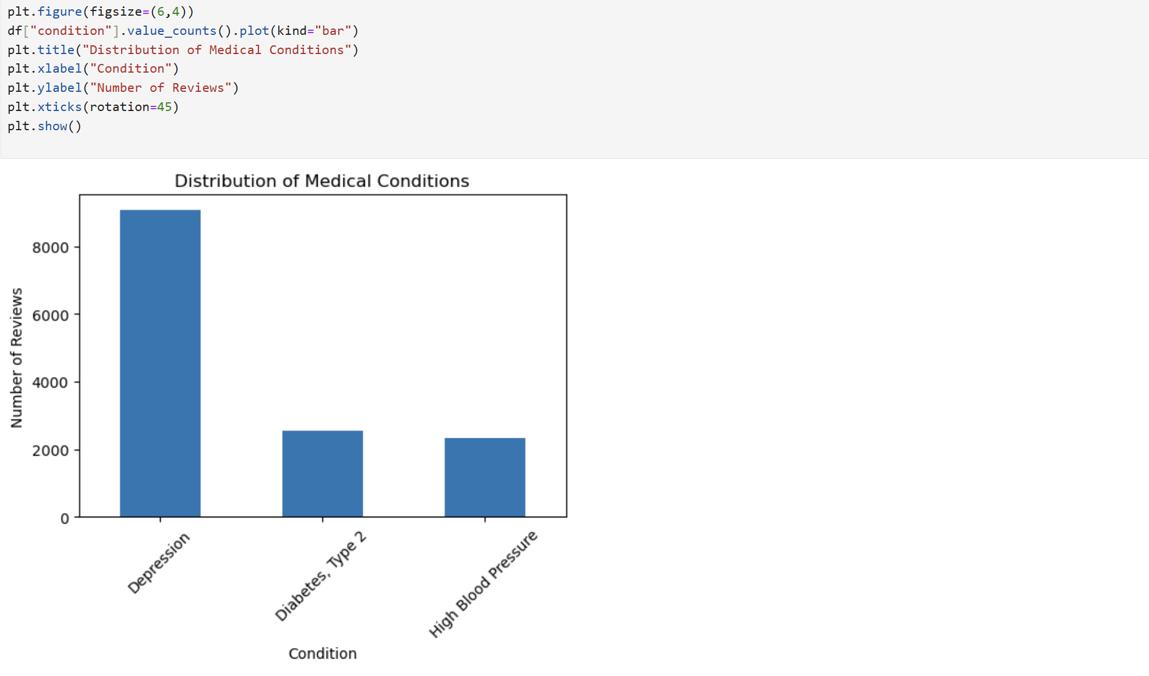
Condition Distribution(EDA)

Slide 9
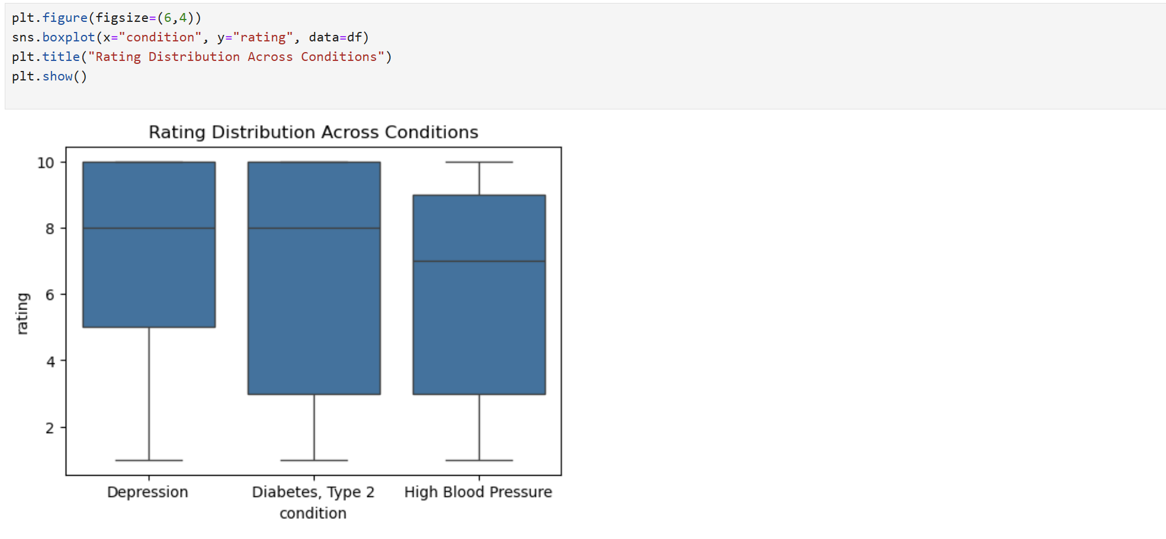
Rating Distribution(EDA)

Slide 10
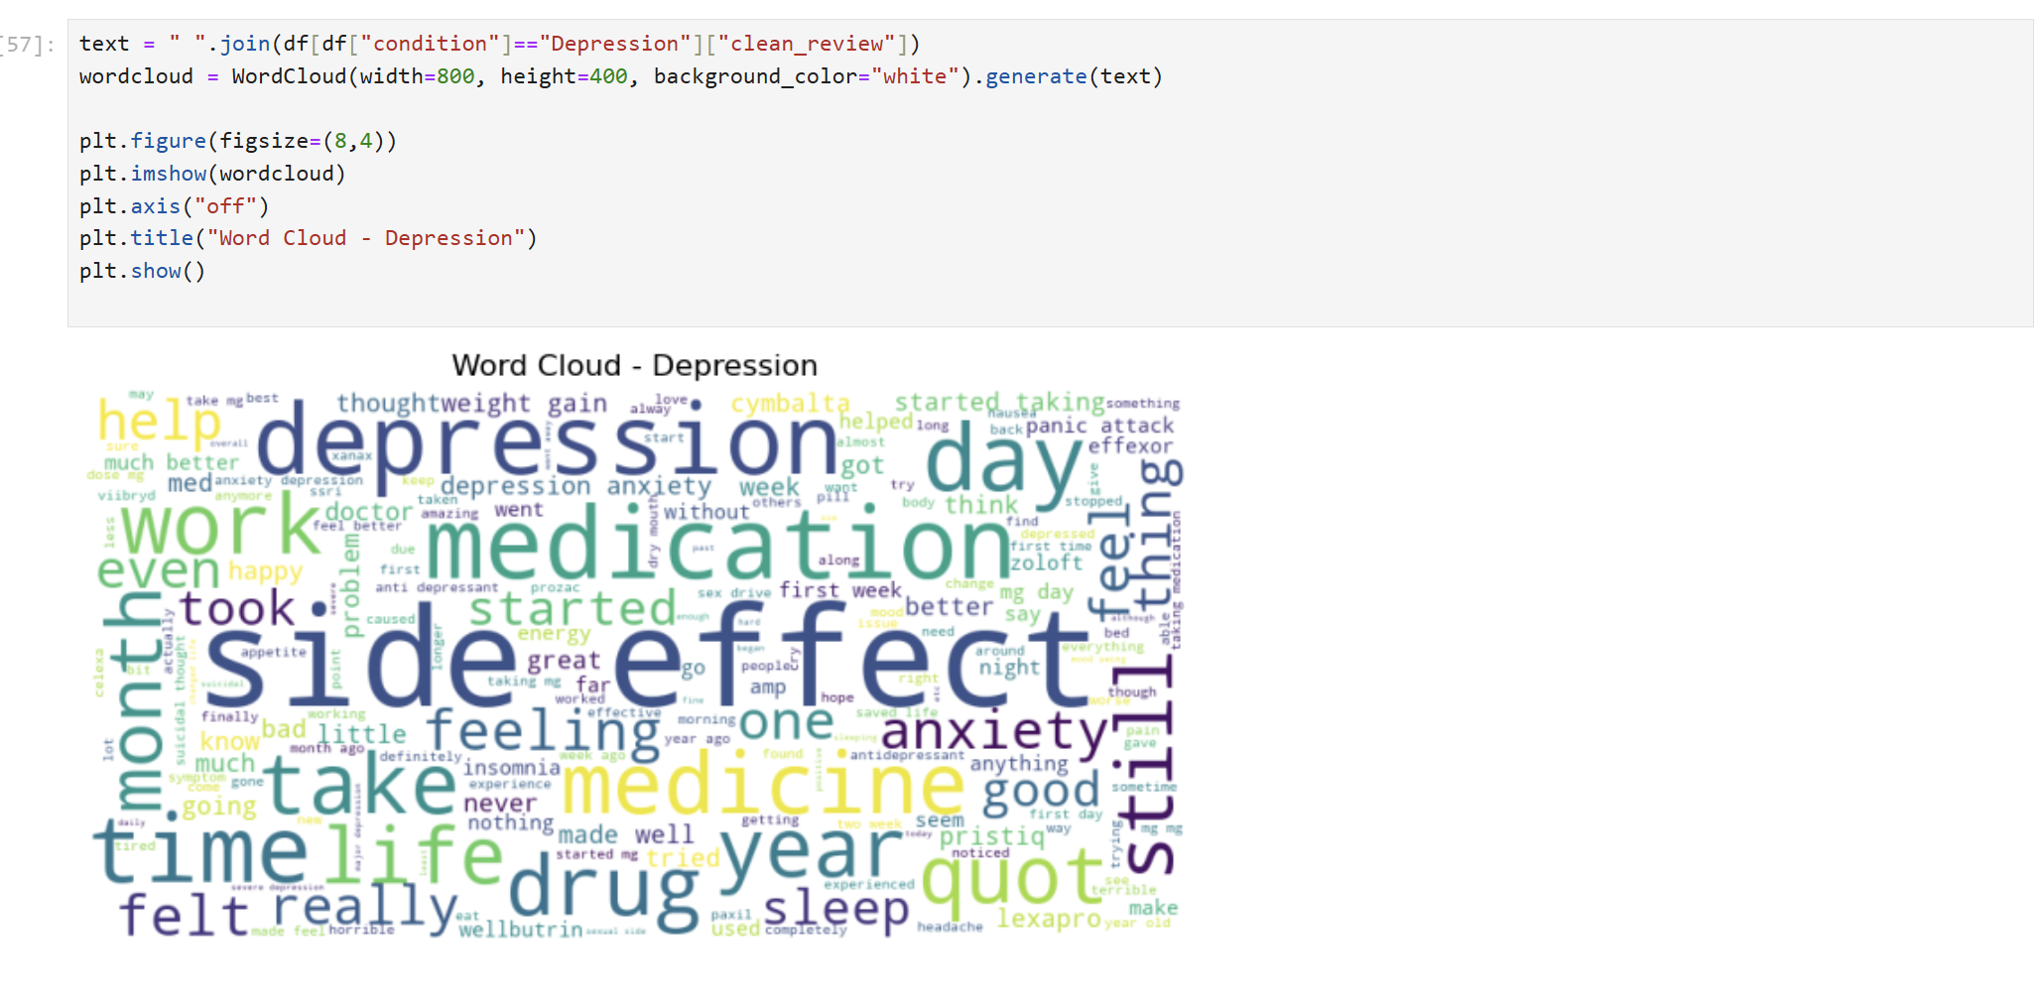
Word Cloud of Patient Reviews(EDA)

Slide 11
Model Building Overview
ThConverted preprocessed review text into numerical features using TF-IDF Vectorization.
Split the dataset into training and testing sets.
Applied classification algorithms such as Logistic Regression, Naïve Bayes, and Random Forest.
Trained models using the training dataset.
Evaluated model performance on the testing dataset using accuracy, precision, recall, and F1-score.
Compared different models and selected the best-performing model for deployment.
Saved the final trained model for prediction in the web application.

Slide 12
Machine Learning Models
Logistic Regression – Used for text classification of patient conditions.
Naïve Bayes (Multinomial Naïve Bayes) – Effective for NLP-based text classification tasks.
Random Forest Classifier – Used to improve prediction accuracy using ensemble learning.
Support Vector Machine (SVM) (if used) – Helps in accurate classification of text data.

Slide 13
Text Vectorization using TF-IDF
TF-IDF (Term Frequency – Inverse Document Frequency) converts text data into numerical format.
It measures the importance of a word in a review relative to the entire dataset.
Words that appear frequently in a review but rarely across other reviews get higher importance.
Common words that appear in many reviews receive lower weights.
Cleaned and preprocessed review text is passed to the TF-IDF Vectorizer.
The vectorizer transforms each review into a numerical feature vector.
These numerical vectors are used as input for machine learning classification models.

Slide 14
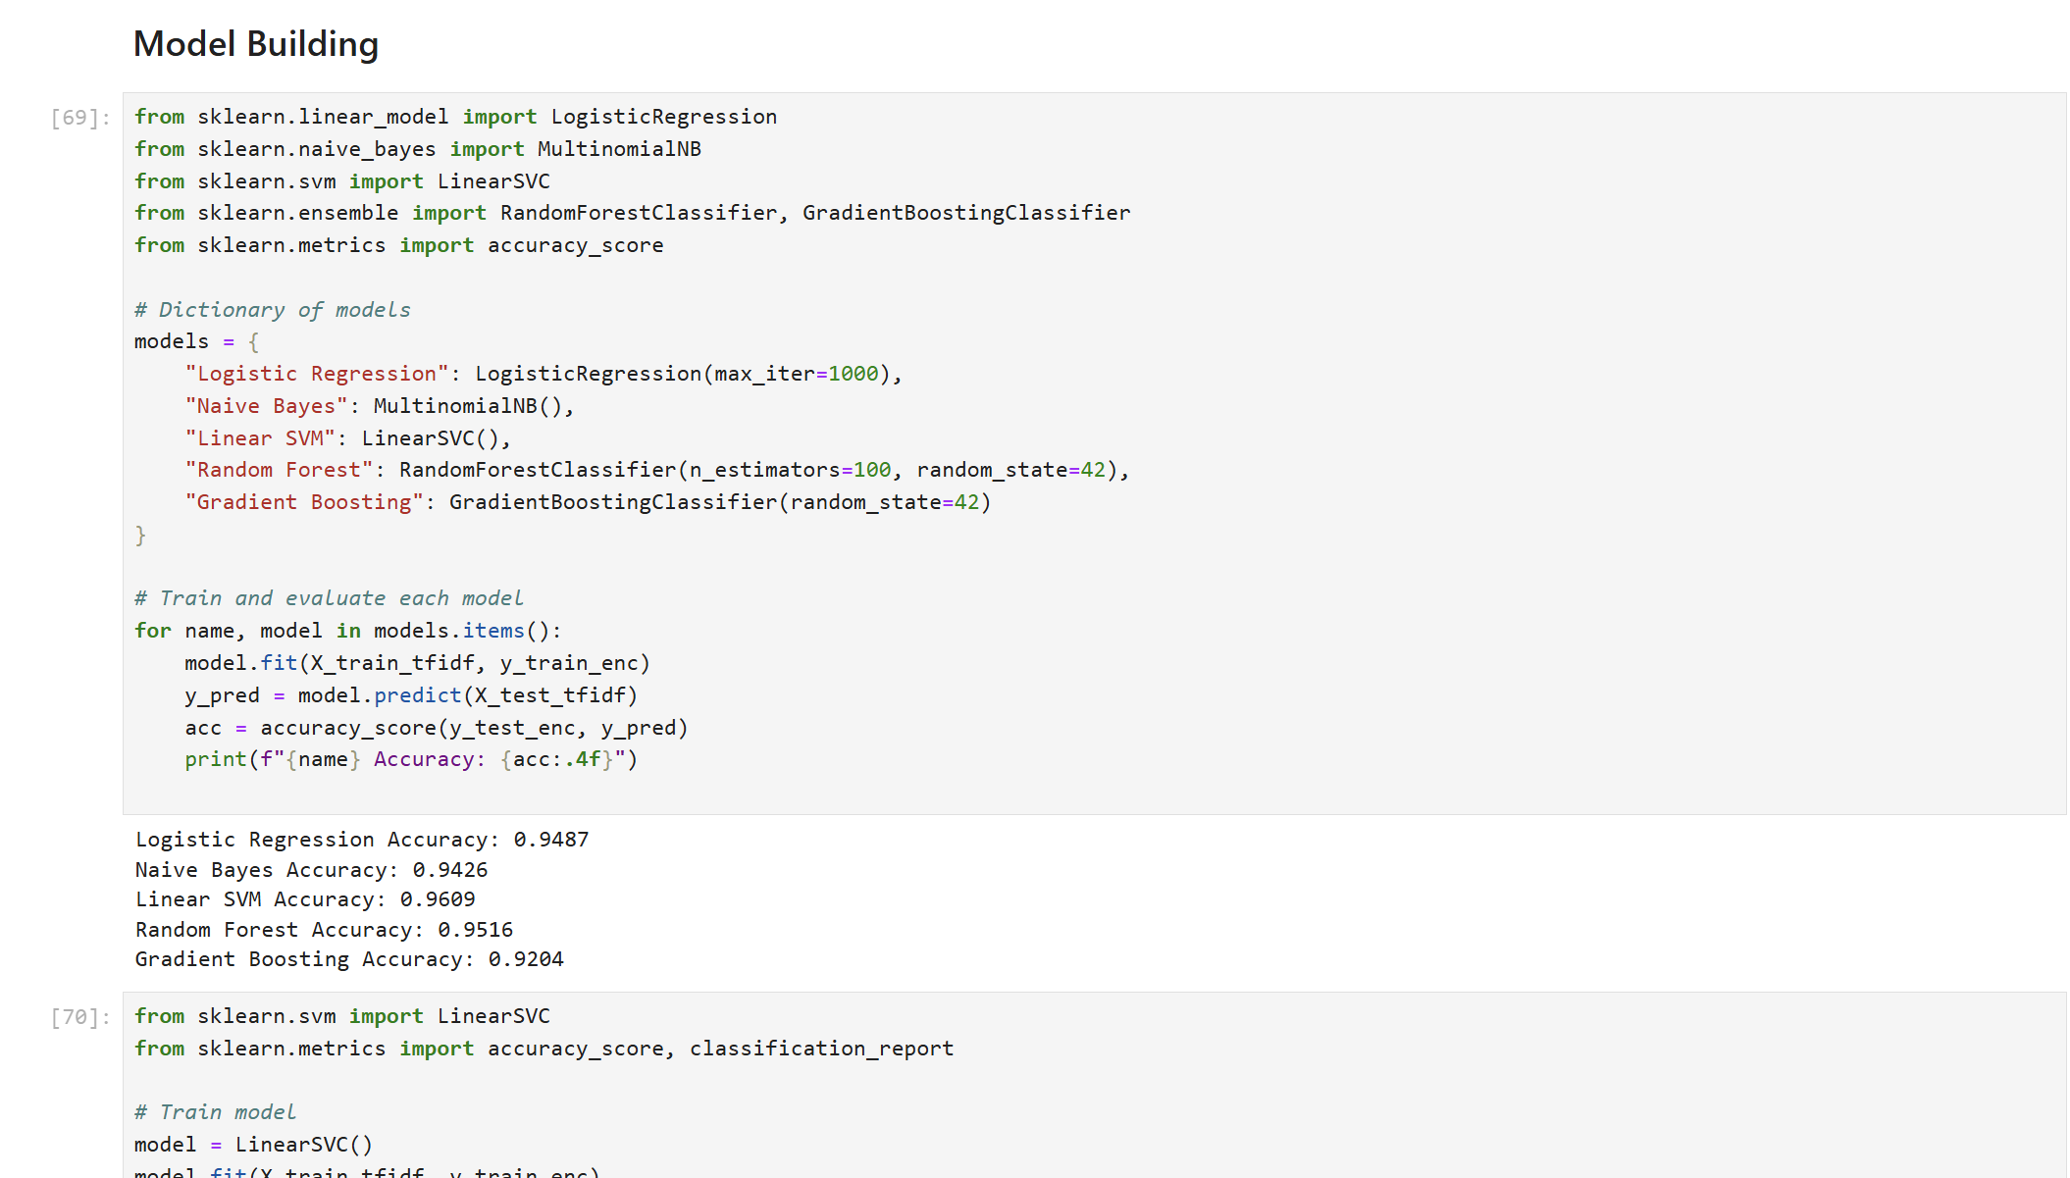
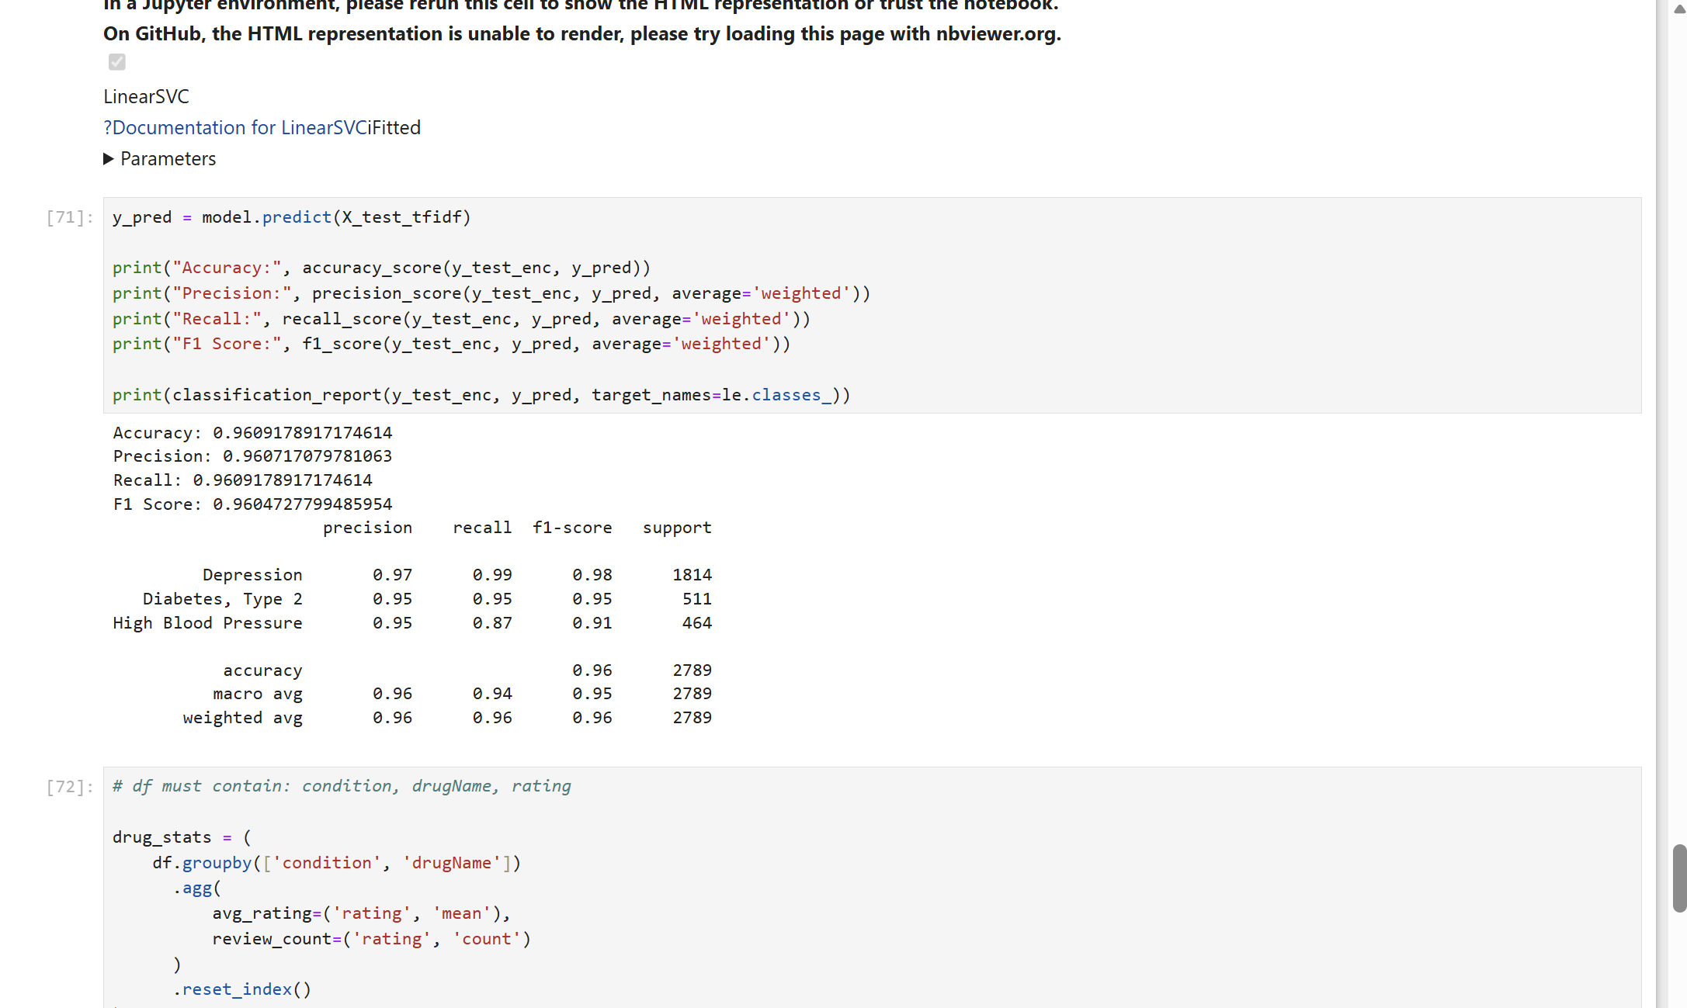
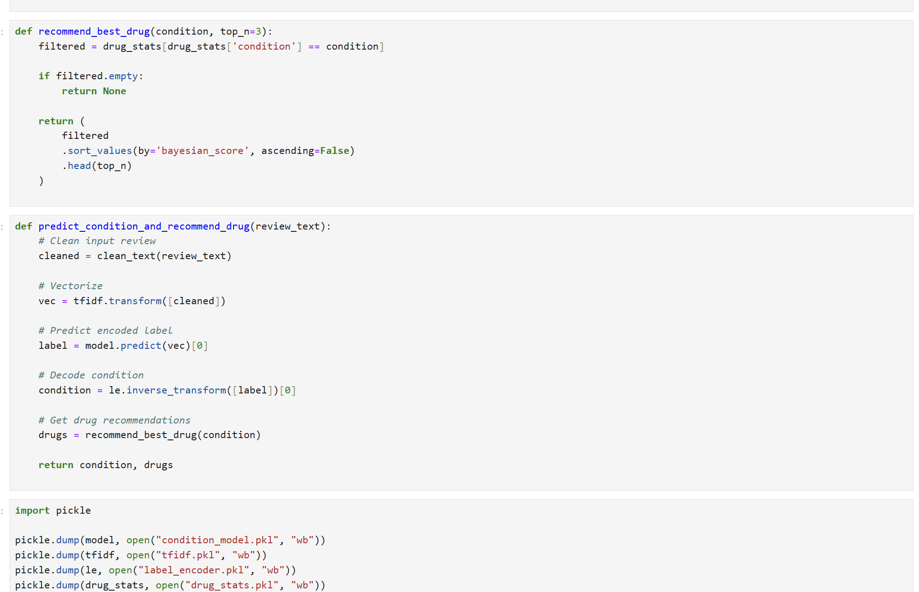
Best Model Selection

Slide 15
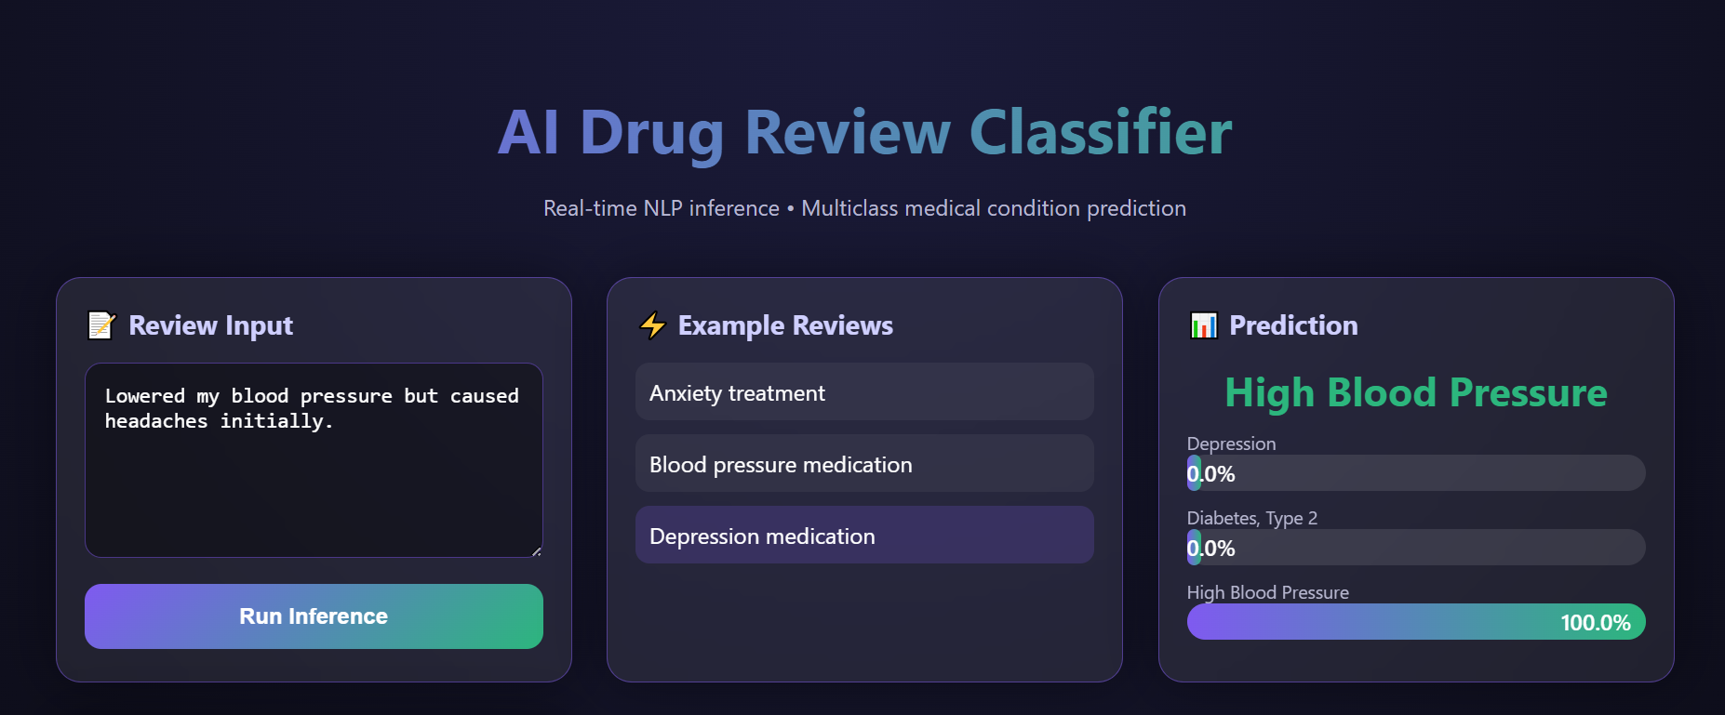
Deployment
1 .Model Deployment Overview
3. Web Application Output
The best-performing trained model was saved using pickle/joblib.
A web application was developed using Flask / Streamlit.
The application accepts user input (patient review text).
Input text is preprocessed and converted using the TF-IDF vectorizer.
The trained model predicts the patient’s medical condition based on the input review.
The predicted result is displayed to the user through the web interface.
The application can be hosted on platforms such as Heroku / Local Server / Cloud for real-time use.

Slide 16
Conclusion
Conclusion
NLP and machine learning techniques were successfully used to analyze patient drug reviews and classify medical conditions.
Text preprocessing and TF-IDF vectorization helped convert textual data into numerical features for model training.
Multiple models were evaluated, and Linear SVM achieved the highest accuracy, making it the final selected model.
The developed system accurately predicts conditions such as Depression, High Blood Pressure, and Type-2 Diabetes.
The final model was deployed as a web application, enabling real-time prediction and practical usage.

Slide 17
THANK YOU..!!

